Slide 1
Advanced Software Engineering
Topic : Function Point
1) Sangam Sushritha Reddy
2) Muga Sudheeth Bharadwaj
3) Addula Lakshmi Narayana Reddy
4) Kalakuntla Vikram Adithya
5) Katipally Rajesh
6) Kuchukulla Vinod Kumar Reddy

Slide 2
Activities During Software Project Management
Diagram:
Size Estimation
Cost Estimation
Development Time
Resource Requirements
Project Scheduling

Slide 3
Overview:
Introduction
History of Function Point
Objective of FP
Types of FP
Complexity
Merits and demerits

Slide 4
Introduction:
Function points are a unit of measurement.
They are a language-independent way of quantifying program functionality.
FPs measure software size. They are widely accepted as an industry standard for functional sizing.

Slide 5
History:
The concept of Function Points was introduced by Alan Albrecht of IBM in 1979 and the first Function Point Guidelines were published in 1984.
The International Function Point Users Group (IFPUG) was founded in 1986 and produced its own Counting Practices Manual.
There are several iterations like CPM 2.0 in 1987, CPM 4.3 in 2010 etc.
The CPM is an internationally approved standard under ISO/IEC 14143-1 Information Technology – Software Measurement.

Slide 6
Objective of Function Point:
Measures software by quantifying the functionality requested by and provided to the customer based primarily on logical design.
Measures software development and maintenance independently of technology used for implementation.
The only variable is the amount of effort needed to deliver a given set of function points; therefore, Function point analysis can be used to determine whether a tool, an environment, a language is more productive compared with others within an organization or among organizations.

Slide 7
Elementary Processes and it’s types:
It is smallest unit of activity which user can understand easily.
It constitutes a complete transaction. It is of two types mentioned below:
Data Functions
Transaction Functions

Slide 8
Data Functions:
Internal Logical Files:
It is maintained by the application.
It is user recognizable.
It is logically related.
External Interface Files:
It is referenced by the application(read only).
The data belongs to and is maintained by another application.
It’s primary intent is Hold data outside application.

Slide 9
Transaction Functions:
External Input: EI processes data or control information that comes from outside the application’s boundary. The EI is an elementary process. It brings data into the application.
External Output: EO is an elementary process that generates data or control information sent outside the application’s boundary. It presents data to the user.
External Inquiries: EQ is an elementary process made up of an input-output combination that results in data retrieval. It does not perform calculations.

Slide 10
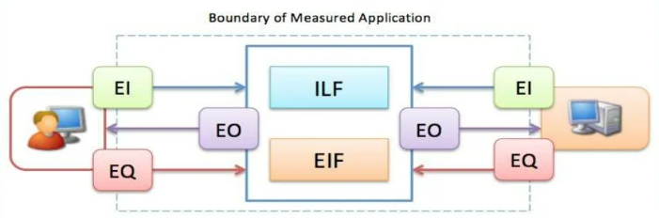
Figure:

Slide 11
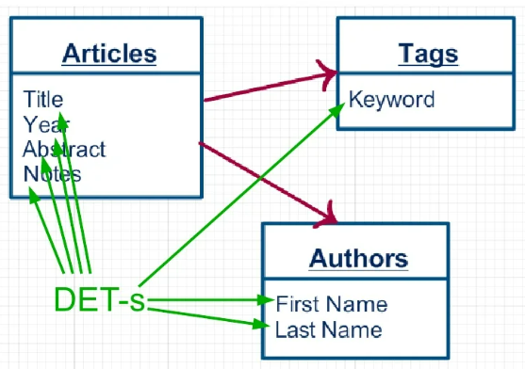
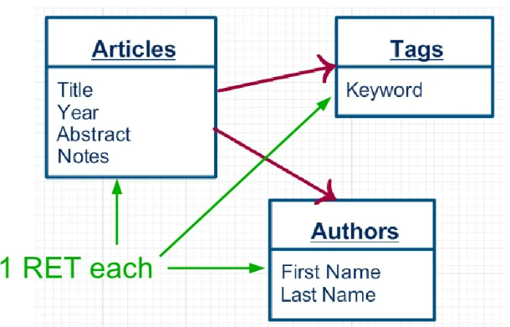
Complexity of data files:
Data Element Type (DET): They are unique data fields.
Record Element Type (RET): They are logical subgroups of data.

Slide 12
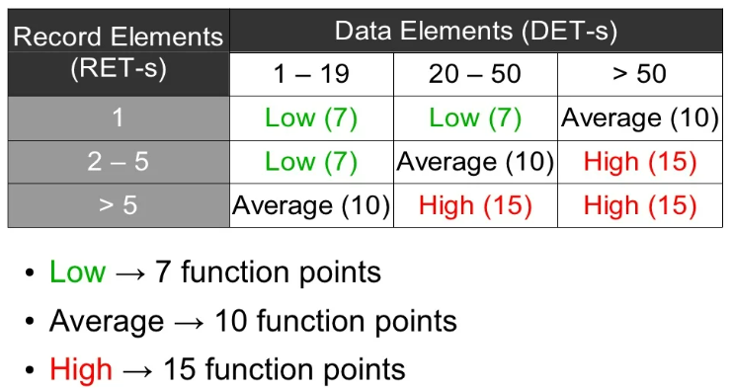
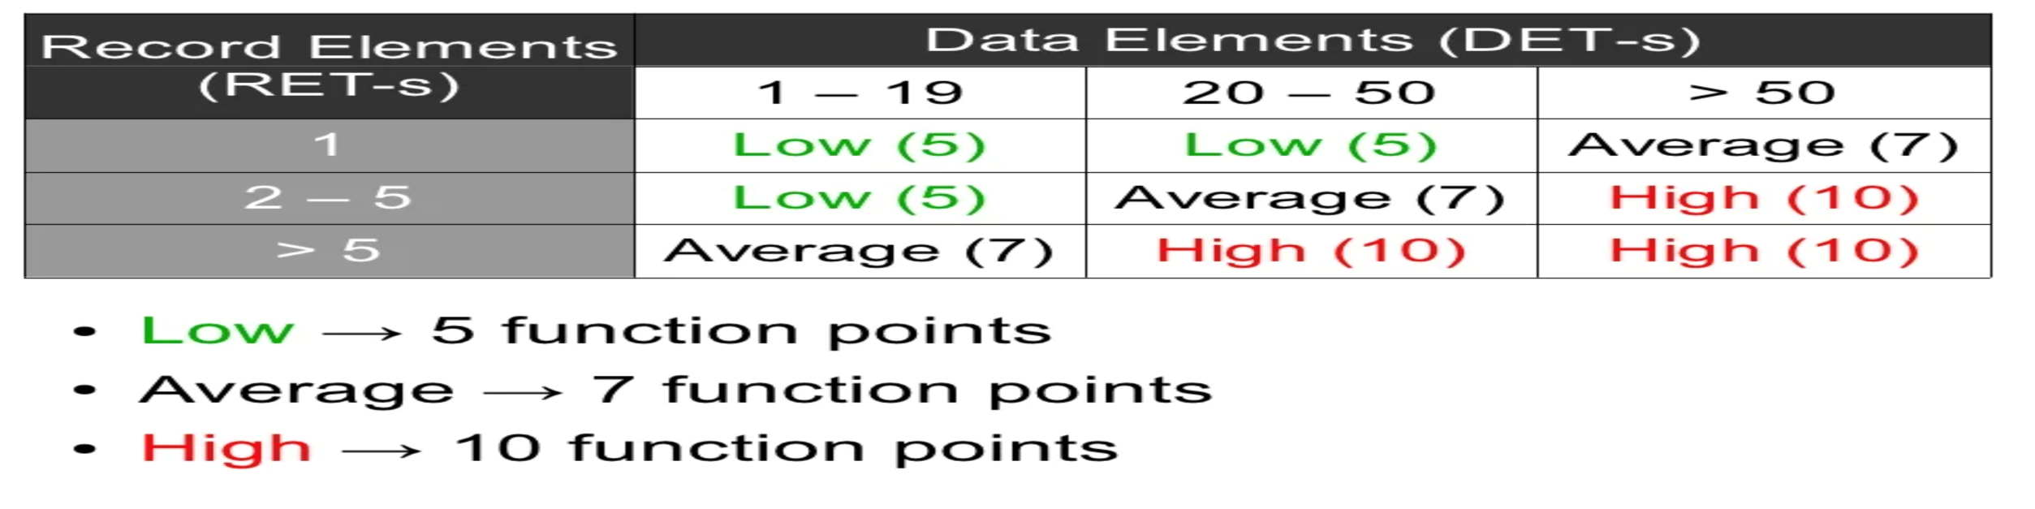
Internal Logical Files Function points :
Function points :
External Interface files

Slide 13
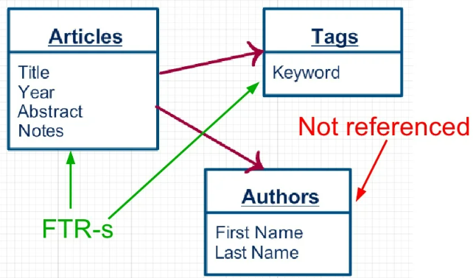
Complexity of transactions:
File Type Referenced (FTR): file type referenced by transaction (input\output\inquiry).

Slide 14
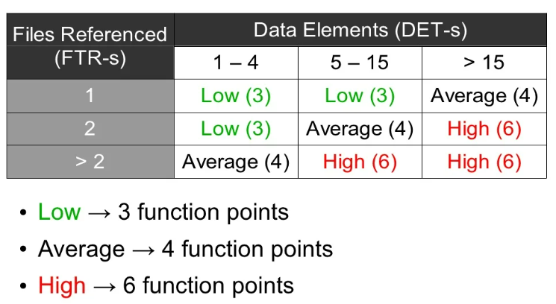
External Input Function points

Slide 15
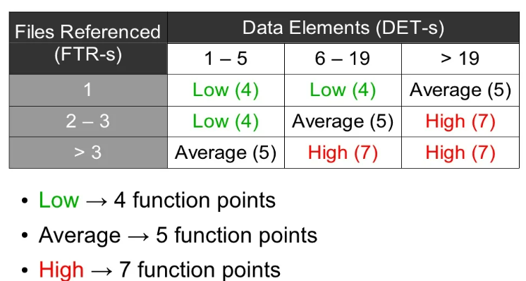
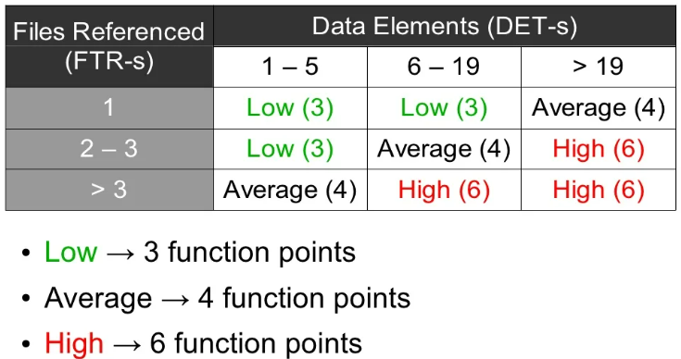
External Output Function points:
External Inquiries Function points :

Slide 16
Steps to Count the Function points
Determine the type of count - Ultimate functions the developers provide.
Functions to update the existing software.
Functions to use and maintain software.
Scoping and Boundary of the Count – the scope and boundary of the functions are identified.
Boundary indicates the border between the application been measured and the external applications.
Scope can be decided with the help of data screens, reports and files.
Unadjusted Function Point Count – in this step the function points produced from all the five FPA components are added together.
Non-adjusted FPC = FP count (ILFs) + FP count (ELFs) + FP count (EIs) + FP count (EOs) + FP count (EQs)

Slide 17
For Example:
Given EI = 10(Low Complexity) , EO = 13 (High Complexity) ,
EQ = 4 (Avg Complexity) , EQ = 2 (High Complexity),
ILF = 2 (Avg Complexity) , EIF = 9 (Low Complexity)
Now the function points produced are
EI = 10 * 3 = 30 , EO = 13 * 7 = 91
EQ = 4 * 4 = 16 , EQ = 2 * 6 = 12
ILF = 2 * 10 = 20 , EIF = 9 * 5 = 45
Total UFP = 214

Slide 18
Value Adjustment Factor (VAF)
Used for rating the general functionality of the application. VAF contains 14 general system characteristics of the application that defines the type of application characteristic and is rated on a scale of 0 - 5.
The sum of all 14 GSC rate are calculated to give out a mathematical value that is defined as Total Degree Influence (TDI). It is used in calculation of VAF, and its value may vary from 0 - 35.
May adjust unadjusted FP value up to +/- 35%
VAF = (TDI*0.01) + 0.65

Slide 19
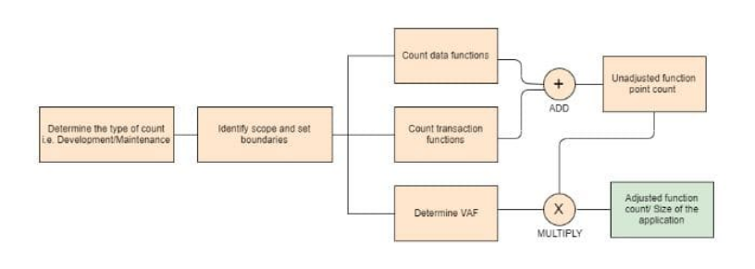
Once the unadjusted function point and value adjustment factor is calculated. Adjusted Functional point is found out by using two values.
Adjusted FPC = Non-adjusted FPC * VAF
Non-adjusted FPC= Unadjusted FP value + Conversion functionality FP value

Slide 20
System Characteristics:
Data Communications
Distributed Data Processing
Performance
Heavily Used Configuration
Transaction Rate
Online Data Entry
End-User Efficiency
Online Update
Complex Processing
Reusability
Installation Ease
Operational Ease
Multiple Sites
Facilitate Change

Slide 21
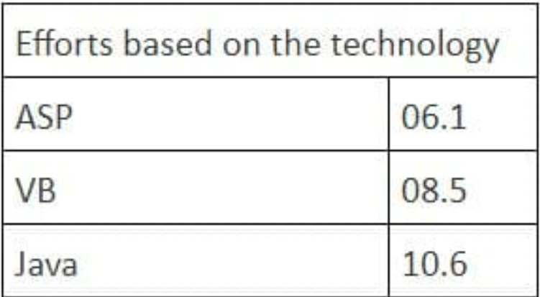
These adjusted FPC is then multiplied with a numeric value, which is the effort based on technology.
If the technology selected for a particular requirement is java, then the formula to calculate the final hours are as follows
FPC = (Non-adjusted FPC * VAF) * 10.6

Slide 22
Merits and Drawbacks of FP:
Merits:
Effort/cost estimation
Benchmarking
Strategic Decision making
Drawbacks of FP:
It requires a subjective evaluation and involves many judgments.
Many cost and effort models are based on LOC, so it is necessary to change the function points.
Compared to LOC, there are less research data on function points.
With subjective judgment, the accuracy rate of the assessment is low.
This is a very time-consuming method.

Slide 23
THANK YOU

